Slide 1

Project Plan
By
Secret Team6

Slide 2
Who
Clinical Trial Management System
Intended Users:
-Clinical Research Coordinators(CRC)
-Study Sponsors
CTMS Capabilities
-Capture, Centralize, and Share Research Data
-Project Management Capabilities
Tracking deadlines
Updating key milestones
-Provides key output data used to confirm research feasibility

Slide 3
What
Clinical Trial Management System
Opportunities for Improvement:
-Require Legacy Software
-Access Issues
-Difficult to Navigate
-Not User Friendly
-Inability to Audit anomalies

Slide 4
How will we accomplish this task
Clinical Trial Management System
Secret Team6 Clinical Trial Management System Capabilities
-Easier to Navigate
-Increased User Friendliness
-Improved Design Layout
-Automated Audits of Data Entry
-Ease of Information Access
-Secure Information Access
-Uniformity/Scalability of Data

Slide 5
Study Description – Cholesterol (LDL)
For this study:
-Sponsor will arrange medication shipments.
-50% Actual cholesterol treatment and the other 50% will be placebos.
-CRC collecting the data and the patient will not know the actual medication
-Only Sponsor will know medication received by patients.
-The CRC will use blood tests to analyze patients response.

Slide 6
Study Description – Cholesterol(LDL)
CTMS that will allow the Sponsor or a CRC to log into the Sponsor’s Database and access client information.
Here is a standard blood test Range: Component Standard Range CHOLESTEROL, TOTAL 100 - 199 mg/dL TRIGLYCERIDES 0 - 149 mg/dL HDL CHOLESTEROL >39 mg/dL VLDL CHOLESTEROL CAL 5 - 40 mg/dL LDL CHOLESTEROL CALC 0 - 99 mg/dL LDL/HDL RATIO 0.0 - 3.6 ratio units

Slide 7
Study Description – Implementation
The following features will be implemented:
-GUI Interface to enter New Research Patient
-GUI Interface to enter Patient Progress.
-Java Backend to Access FIHR Interface
-GUI Interface used to implement search test scenario
-Implement local Storage of data for patients
-Sponsor Informational Dashboard
-CRC Dashboard w/ To-do List
-Graphs and Charts
-Display Benchmark Dashboard

Slide 8
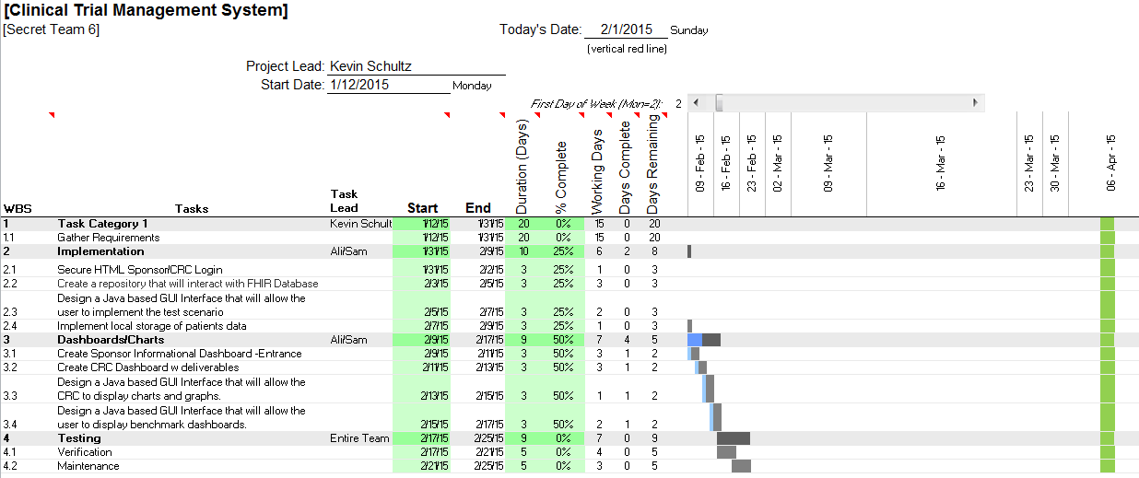
Gantt Chart

Slide 9
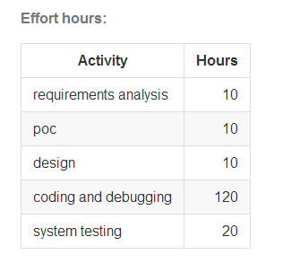
Estimated Time

Slide 10
Secret Team6
Team Members Chase Anderson
Cecil Bowe
Alireza Mansoori
Kevin Schultz Roderick Shavers Samuel Tjokrosoesilo

